Slide 1
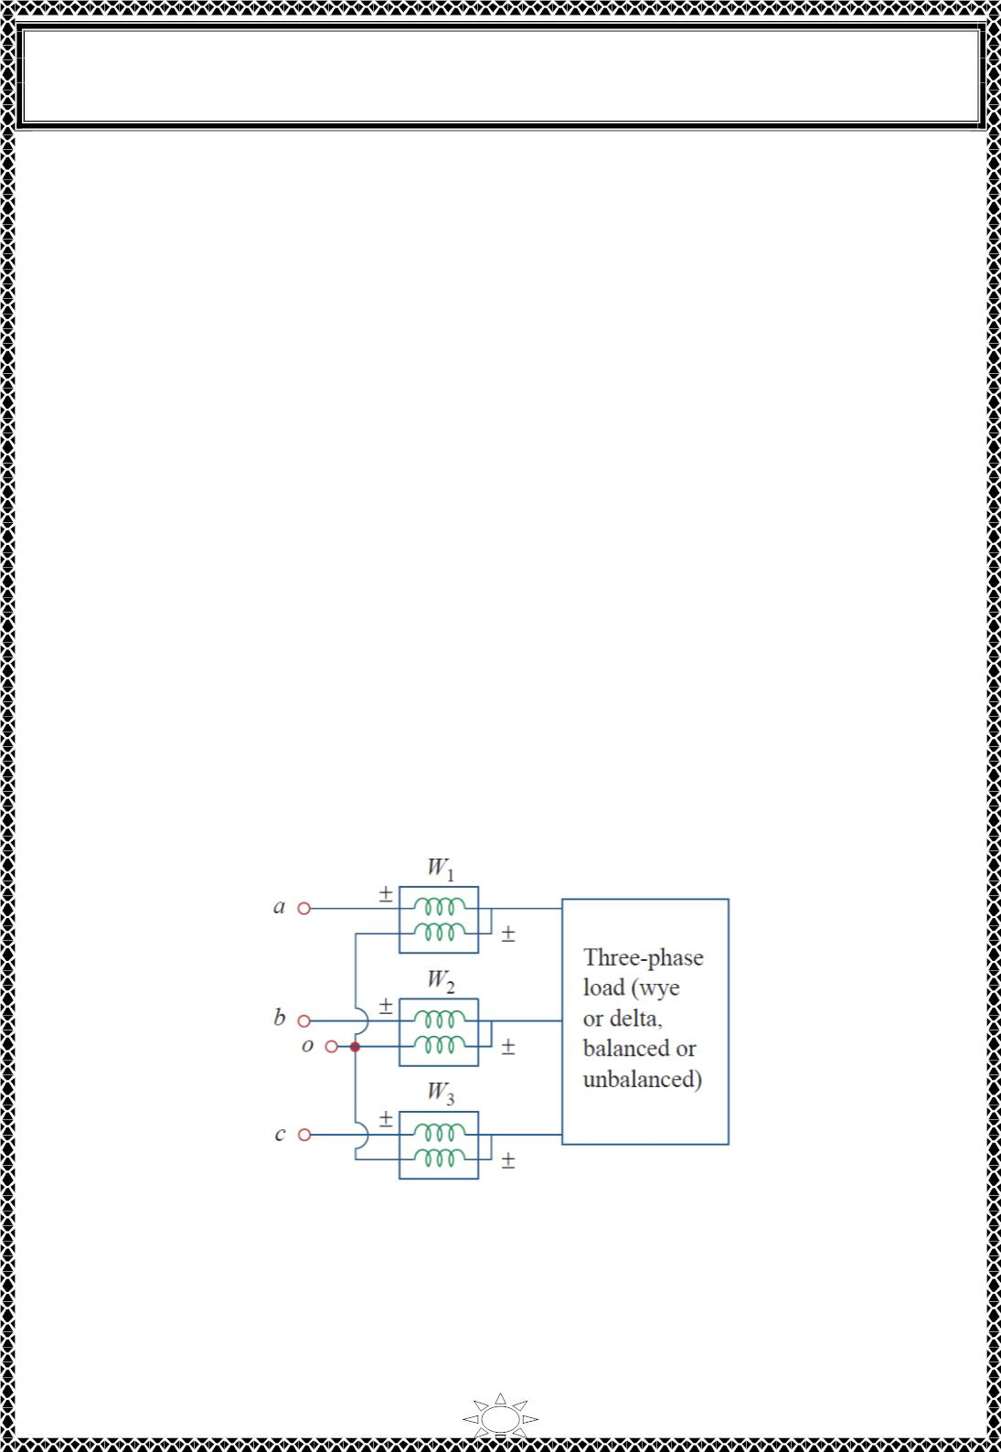
University of Diyala
Engineering College
Electronic Department
Electrical Circuits
2nd Class
Lecturer : Wisam N. AL-Obaidi
Year (2015-2016)
6) Three-Phase Power Measurement
A single wattmeter can measure the average power in a three-phase system that is
balanced, so that P1 = P2 = P3; the total power is three times the reading of that one
wattmeter. However, two or three single-phase wattmeter are necessary to measure power
if the system is unbalanced. However, there are two methods for measuring the power in
unbalanced three-phase systems;
1) Three-wattmeter method.
2) Two-wattmeter method.
6.1) Three-wattmeter method
The three wattmeter method of power measurement, shown in Fig.6.1, will work
regardless of whether the load is balanced or unbalanced, wye or delta-connected. The
three-wattmeter method is well suited for power measurement in a three-phase system
where the power factor is constantly changing. The total average power is the algebraic
sum of the three wattmeter readings,
P = P + P + P
…(6.1)
where P , P , and P correspond to the readings of wattmeters W , W , and W and
T
1
1
2
2
3
3
1
2
3
Trail Version
Trail Version
Trail Version
Trail Version
Trail Version
Trail Version
Trail Version
Trail Version
Trail Version
Trail Version
Trail Version
Trail Version
Trail Version
respectively. Notice that the common or reference point o in Fig.6.1 is selected arbitrarily.
If the load is wye-connected, point o can be connected to the neutral point n. For a delta-
connected load, point o can be connected to any point. If point o is connected to point b,
for example, the voltage coil in wattmeter W reads zero and P = 0 indicating that
2
2
wattmeter W₂ is not necessary. Thus, two wattmeters are sufficient to measure the total
power.
Fig.6.1 Three-wattmeter method for measuring three-phase power.
6.1) Two-wattmeter method
For many load configurations, for example, a three-phase motor, the phase current or
voltage is inaccessible. We may wish to measure power with a wattmeter connected to
each phase. However, because the phases are not available, we measure the line currents
and the line-to-line voltages.
31

Slide 2
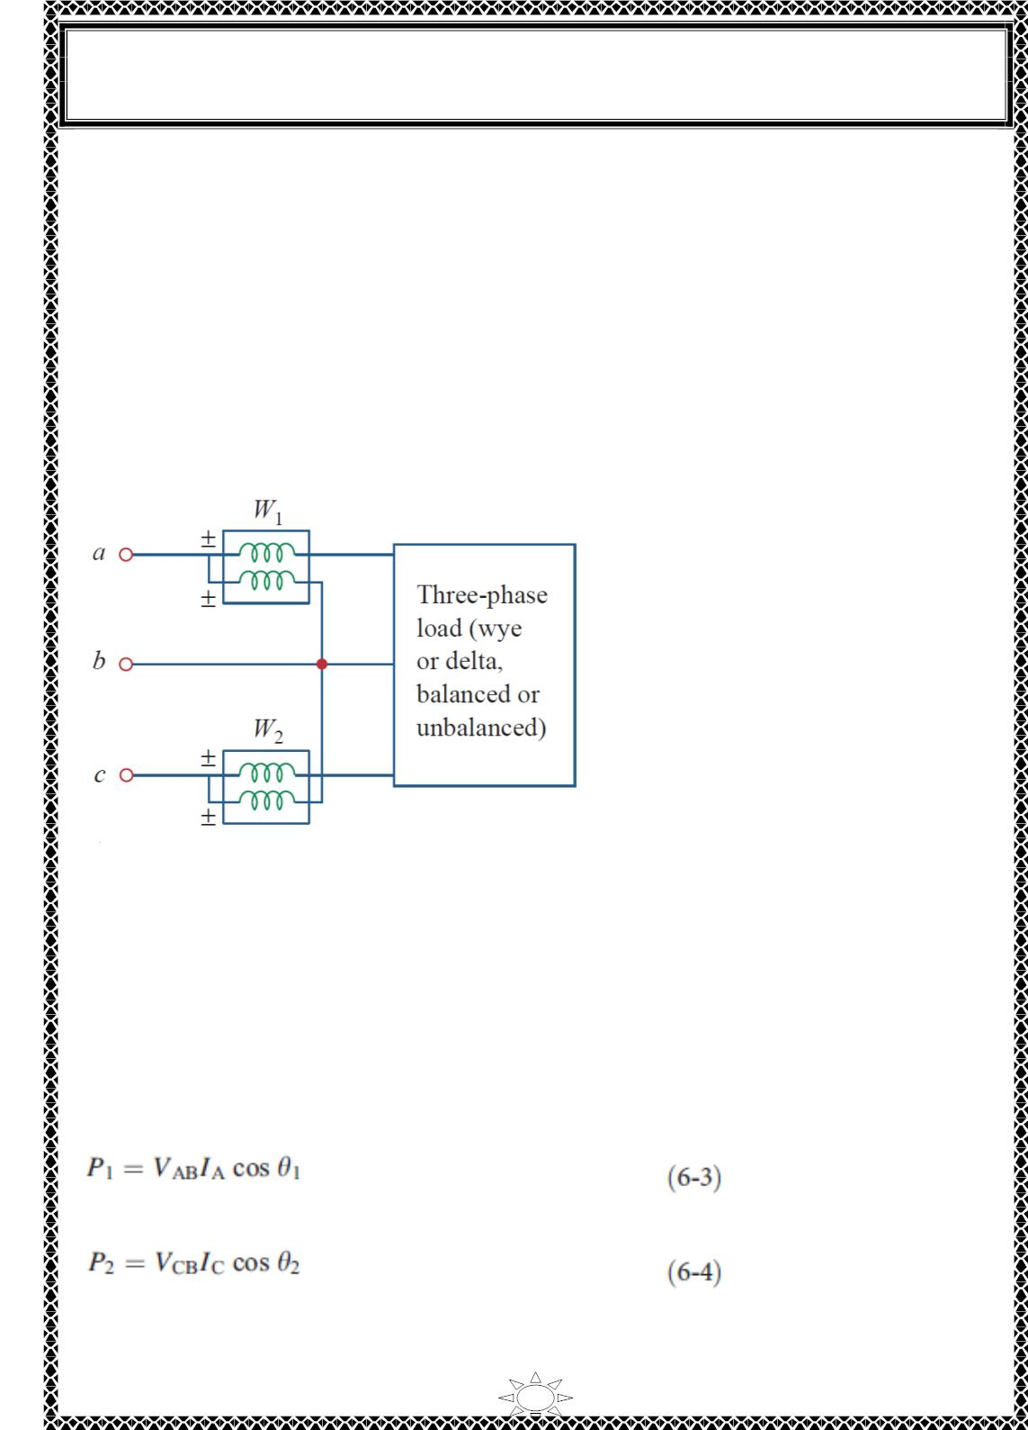
University of Diyala
Engineering College
Electronic Department
Electrical Circuits
2nd Class
Lecturer : Wisam N. AL-Obaidi
Year (2015-2016)
The two-wattmeter method is the most commonly used method for three-phase power
measurement. The two wattmeters must be properly connected to any two phases, as
shown typically in Fig.6.2. Notice that the current coil of each wattmeter measures the line
current, while the respective voltage coil is connected between the line and the third line
and measures the line voltage. Also notice that the ± terminal of the voltage coil is
connected to the line to which the corresponding current coil is connected. Although the
individual wattmeters no longer read the power taken by any particular phase, the
algebraic sum of the two wattmeter readings equals the total average power absorbed by
the load, regardless of whether it is wye- or delta-connected, balanced or unbalanced. The
total real power is equal to the algebraic sum of the two wattmeter readings,
P = P + P
2
…(6.2)
T
1
Trail Version
Trail Version
Trail Version
Trail Version
Trail Version
Trail Version
Trail Version
Trail Version
Trail Version
Trail Version
Trail Version
Trail Version
Trail Version
Fig.6.2 Two-wattmeter method for measuring three-phase power.
Now will show that the method works for a balanced three-phase system.
Consider the balanced, wye-connected load in Fig.6.3. Our objective is to apply the two-
wattmeter method to find the average power absorbed by the load. Assume the source is in
the abc sequence and the load impedance 푍 = 푍 ∠휃. Due to the load impedance, each
푌
푌
voltage coil leads its current coil by 휃, so that the power factor is 퐶푂푆휃. We recall that
each line voltage leads the corresponding phase voltage by 30⁰. Thus, the total phase
difference between the phase current and line voltage Vab is 휃 + 30ꢀ, and the average
power read by wattmeter W and W are,
1
2
For the abc phase sequence for a balanced load,
32

Slide 3
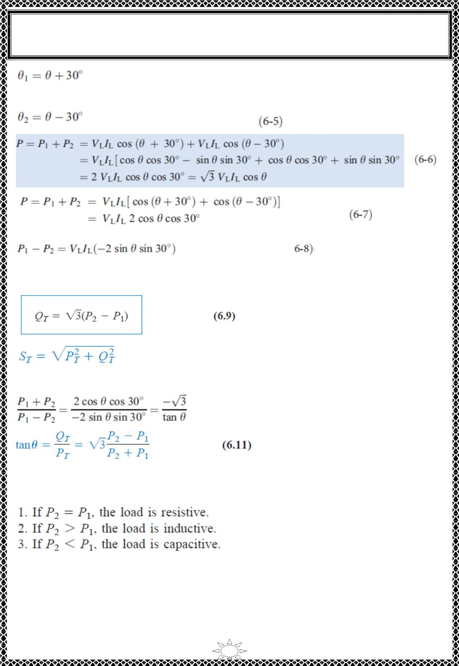
University of Diyala
Engineering College
Electronic Department
Electrical Circuits
2nd Class
Lecturer : Wisam N. AL-Obaidi
Year (2015-2016)
Similarly,
Note that the difference of the wattmeter readings is proportional to the total reactive
power, or
Trail Version
Trail Version
Trail Version
Trail Version
Trail Version
Trail Version
Trail Version
Trail Version
Trail Version
Trail Version
Trail Version
Trail Version
Trail Version
Divide Equ.(6.6) on (6.8),
…(6.10)
from which we can obtain the power factor as Thus, the two-wattmeter method not only
provides the total real and reactive powers, it can also be used to compute the power
factor. From Eqs. (6.7), (6.9), and (6.11), we conclude that:
Although these results are derived from a balanced wye-connected load, they are equally
valid for a balanced delta-connected load. However, the two-wattmeter method cannot be
used for power measurement in a three-phase four-wire system unless the current through
the neutral line is zero. We use the three-wattmeter method to measure the real power in a
three-phase four-wire system.
33

Slide 4
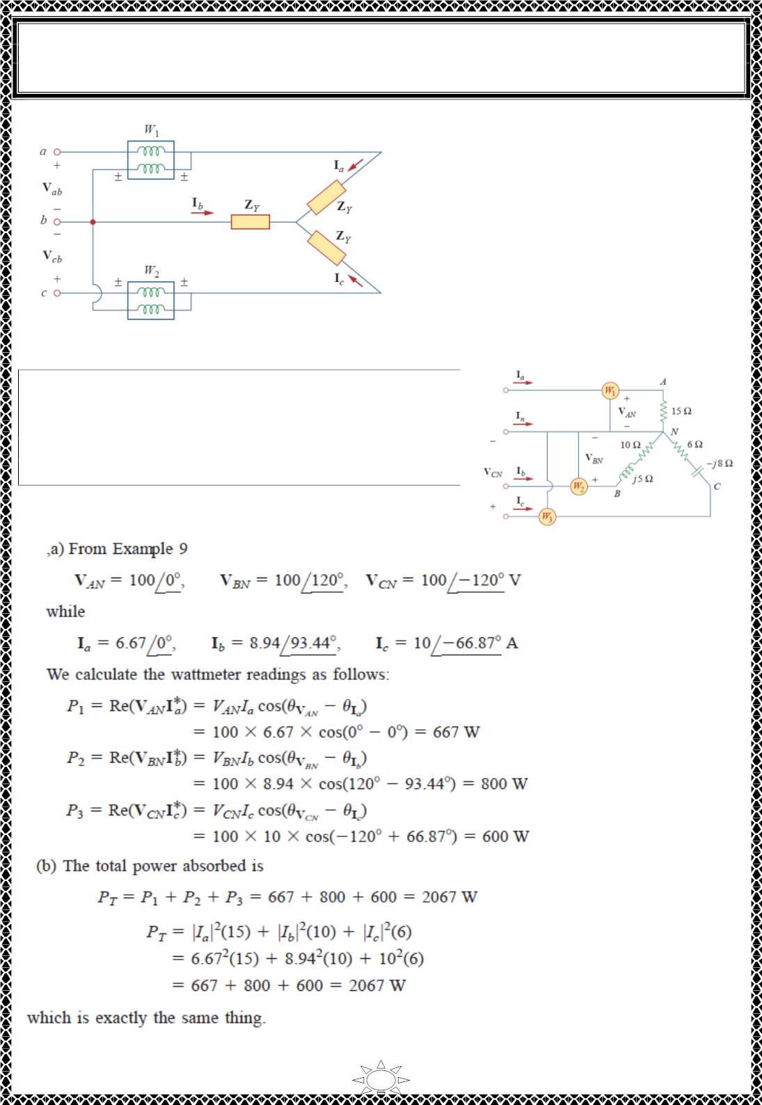
University of Diyala
Engineering College
Electronic Department
Electrical Circuits
2nd Class
Lecturer : Wisam N. AL-Obaidi
Year (2015-2016)
Fig.6.3 Two-wattmeter method applied to a balanced wye load.
Example 11: Three wattmeters W , W and W are
1
2
3
connected, respectively, to phases a, b, and c to
measure the total power absorbed by the unbalanced
wye connected load in Example 9 (a) Predict the
wattmeter readings. (b) Find the total power absorbed.
Solution:
Trail Version
Trail Version
Trail Version
Trail Version
Trail Version
Trail Version
Trail Version
Trail Version
Trail Version
Trail Version
Trail Version
Trail Version
Trail Version
34

Slide 5
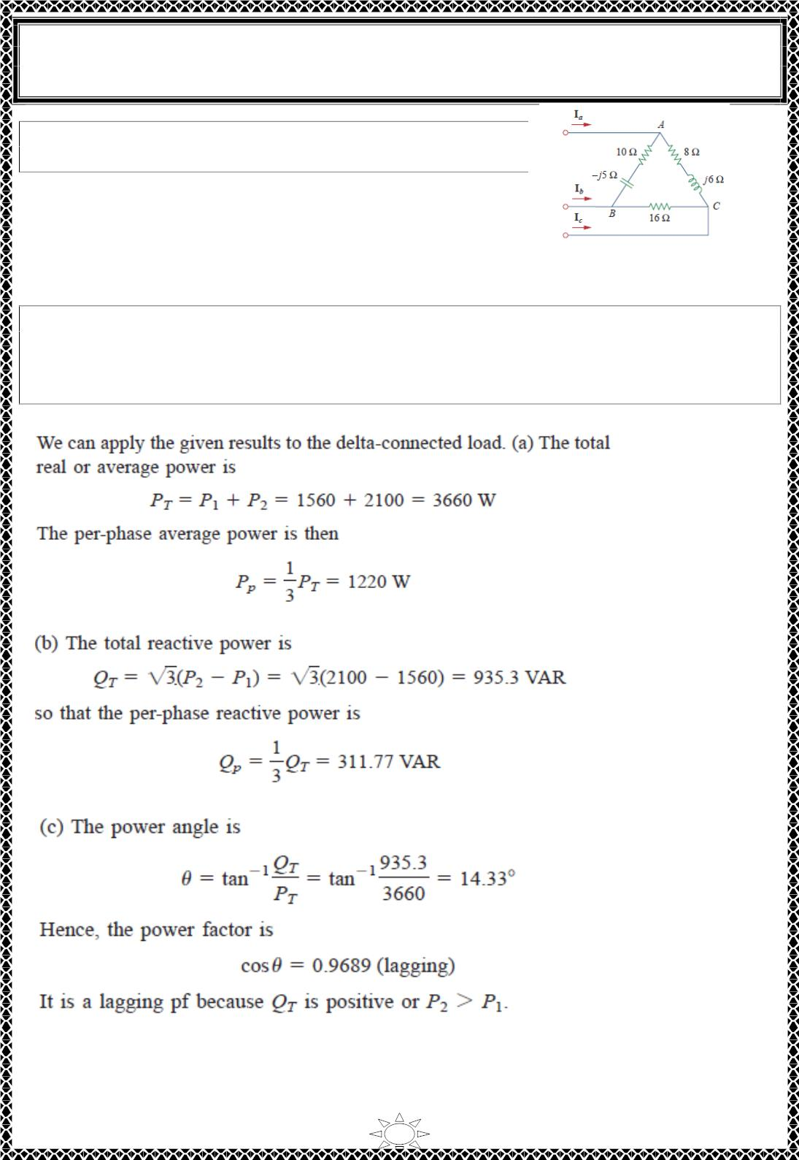
University of Diyala
Engineering College
Electronic Department
Electrical Circuits
2nd Class
Lecturer : Wisam N. AL-Obaidi
Year (2015-2016)
H.W.11: Repeat Example 11 for the network in (H.W. 9).
Hint: Connect the reference point o in Fig.6.1 to point B.
Answer: (a) 3.92 kW, 0 W, 8.895 kW, (b) 12.815 kW.
Example 12: The two-wattmeter method produces wattmeter readings P1 = 1560 W and
P2 = 2100 W when connected to a delta-connected load. If the line voltage is 220 V,
calculate: (a) the per-phase average power, (b) the perphase reactive power, (c) the power
factor, and (d) the phase impedance.
Solution:
Trail Version
Trail Version
Trail Version
Trail Version
Trail Version
Trail Version
Trail Version
Trail Version
Trail Version
Trail Version
Trail Version
Trail Version
Trail Version
35

Slide 6
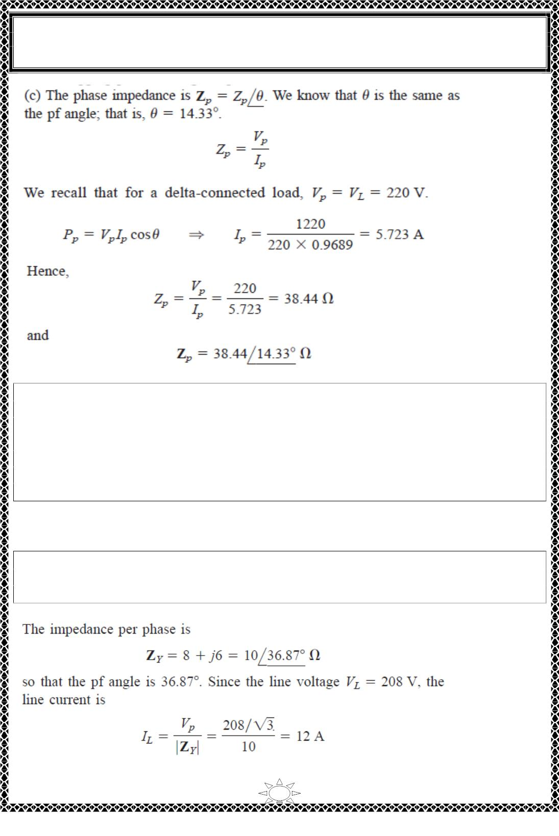
University of Diyala
Engineering College
Electronic Department
Electrical Circuits
2nd Class
Lecturer : Wisam N. AL-Obaidi
Year (2015-2016)
Trail Version
Trail Version
Trail Version
Trail Version
Trail Version
Trail Version
Trail Version
Trail Version
Trail Version
Trail Version
Trail Version
Trail Version
Trail Version
H.W.12: Let the line voltage V_{L} = 208 V and the wattmeter readings of the balanced
system in Fig.6.2 be P = -560 W and P = 800 W. Determine:
1
(a) the total average power
(b) the total reactive power
(c) the power factor
2
(d) the phase impedance
Is the impedance inductive or capacitive?
Answer: (a) 240 W, (b) 2355.6 VAR, (c) 0.1014, (d) 18.25∠84.18⁰ Ω, inductive.
Example 13: The three-phase balanced load in Fig.6.2 has impedance per phase of Z_{Y} =
8 + j6 Ω. If the load is connected to 208-V lines, predict the readings of the wattmeters
W and W . Find P and Q .
1
2
T
T
Solution:
36

Slide 7
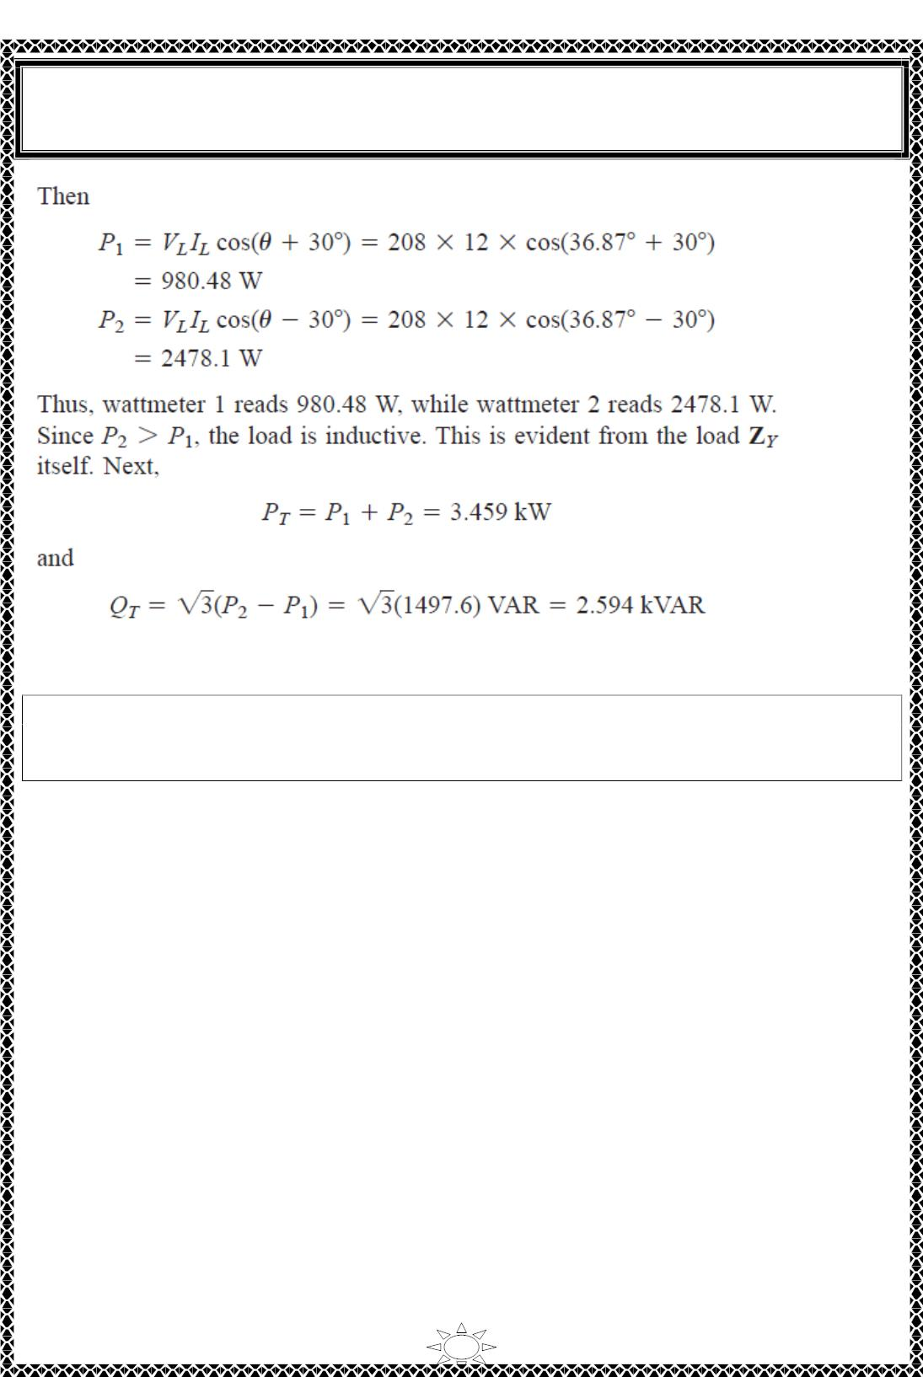
University of Diyala
Engineering College
Electronic Department
Electrical Circuits
2nd Class
Lecturer : Wisam N. AL-Obaidi
Year (2015-2016)
Trail Version
Trail Version
Trail Version
Trail Version
Trail Version
Trail Version
Trail Version
Trail Version
Trail Version
Trail Version
Trail Version
Trail Version
Trail Version
H.W.13: If the load in Fig.6.2 is delta-connected with impedance per phase of Z_{p} = 30 –
j40 Ω and V = 440 V. predict the readings of the wattmeters W and W . Calculate P and
Q .
L
1
2
T
T
Answer: 6.166 Kw, 0.8021 Kw, 6.968 Kw, -9.291 kVAR.
37

Slide 8
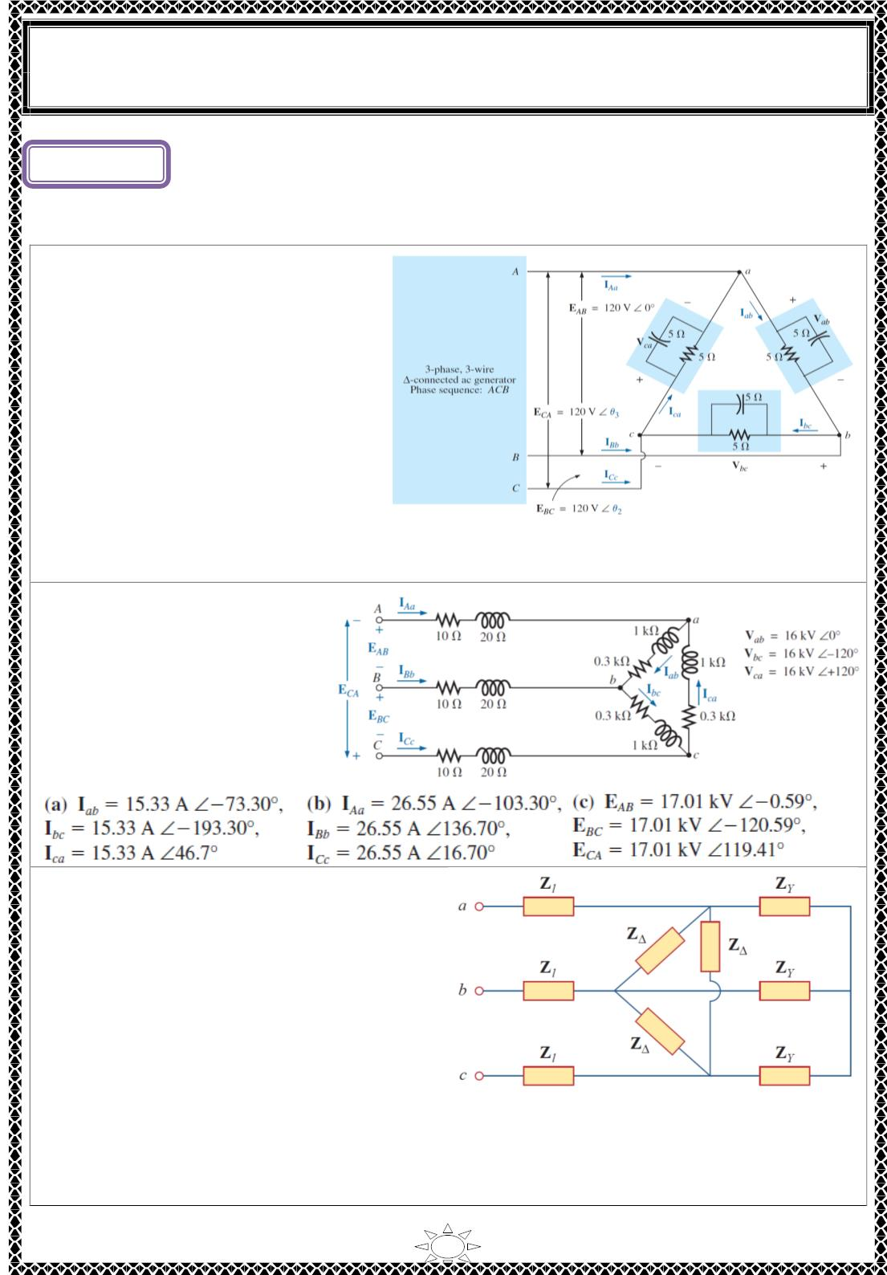
University of Diyala
Engineering College
Electronic Department
Electrical Circuits
2nd Class
Lecturer : Wisam N. AL-Obaidi
Year (2015-2016)
vLecture ()
Three Phase Circuits
Problems
H.W.(1): For the three-phase ∆ −
∆ system in Figure shown, Find the
phase and line currents. Draw phasor
diagram.
[Answer: I = 33.9∠ퟒퟓ A, I = 33.9∠ퟏퟔퟓ^{ퟎ}
AB
ퟎ
BC
A, ICA = 33.9∠ − ퟕퟓ A, IA = 58.82∠ퟕퟓퟎ
ퟎ
∠ − ퟒퟓ^{ퟎ}
A, I = 58.82∠ퟏퟗퟓ A, I = 58.82
A]
B
C
Trail Version
Trail Version
Trail Version
Trail Version
Trail Version
Trail Version
Trail Version
Trail Version
Trail Version
Trail Version
Trail Version
Trail Version
Trail Version
H.W.(2): For the ∆-connected
load in Figure, find the line
voltages, phase currents and
line currents. Draw the phasor
diagram.
[Answer:]
H.W.(3): The circuit in Figure is excited by
a balanced three-phase source with a line
voltage of 210 V. If Zℓ = 1 + j1 Ω, Z _{Δ} = 24
− j30 Ω, and Z_{Y} = 12 + j5 Ω, determine the
magnitude of the line current of the
combined loads.
ퟎ
[Answer: I = 13.66∠ퟔ ∙ ퟕퟖ A]
a
1

Slide 9
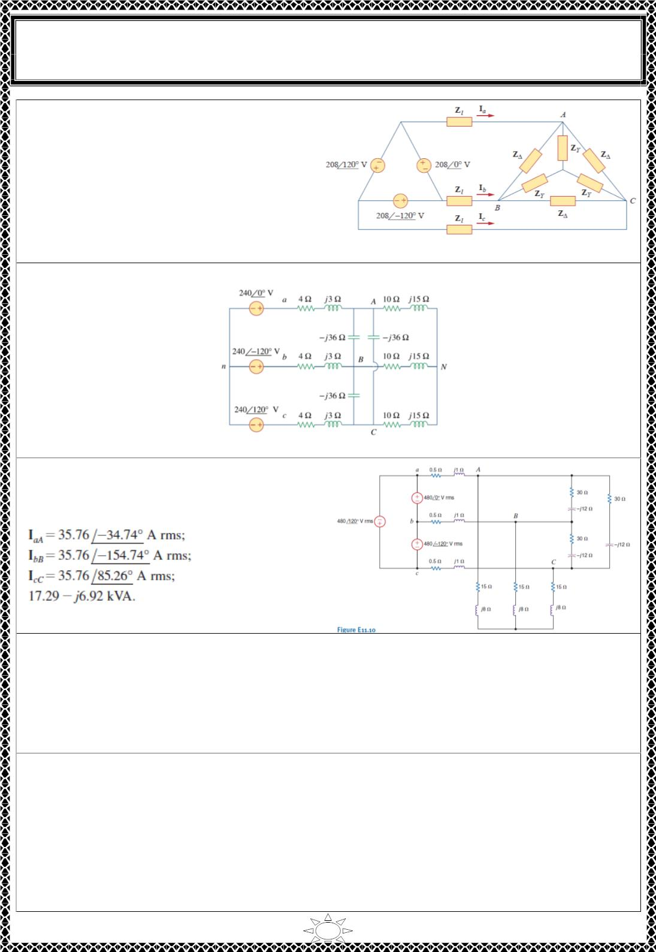
University of Diyala
Engineering College
Electronic Department
Electrical Circuits
2nd Class
Lecturer : Wisam N. AL-Obaidi
Year (2015-2016)
H.W.(4): Find the line currents I , I , and
a
b
I_{c} in the three-phase network of Figure
below. Take Z = 12 − j15 Ω, Z = 4 + j6
Δ
Y
Ω, and Zℓ = 2 Ω.
[Answer: I = 15.53∠−ퟐퟖ ∙ ퟒ A, I = 15.53∠−ퟏퟒퟖ ∙ ퟒ^{ퟎ}
a
ퟎ
b
A, Ic = 15.53∠ퟗퟏ ∙ ퟔퟎ A]
H.W.(5): Given the circuit in Figure shown, determine currents IaA and voltage VBN
.
Trail Version
Trail Version
Trail Version
Trail Version
Trail Version
Trail Version
Trail Version
Trail Version
Trail Version
Trail Version
Trail Version
Trail Version
Trail Version
[Answer: I = 11.15∠ퟑퟕ A, V = 230.8∠−ퟏퟑퟑ ∙ ퟒ^{ퟎ}
a
ퟎ
BN
V,]
H.W.(6): Find the line currents and the
power absorbed by the delta-connected load.
[Answer:]
H.W.(7): In a balanced three-phase system, the abc phase sequence source is delta
ퟎ
connected and V = 120∠ퟑퟎ rms. The load consists of two balanced wyes with phase
ab
impedances of (10 + j1)Ω and (20 + j5)Ω. If the line impedance is zero, find the line
currents and the load phase voltages using one line equivalent circuit.
[Answer: Van = 69.28∠ퟎퟎ퐕 = VAN , IAN1 = 6.89∠−ퟓ ∙ ퟖퟏퟎ A, IAN2 = 3.36∠−ퟏퟒ ∙ ퟎퟒퟎ A,
Ia = IAN1 + IAN2 = 10.23∠−ퟖ ∙ ퟒퟒ A, I = 10.23∠−ퟏퟐퟖ ∙ ퟒퟒ^{ퟎ}
ퟎ
b
A, Ic = 10.23∠ퟏퟏퟏ ∙ ퟓퟔퟎA]
H.W.(8): In a balanced three-phase system, the source has an abc phase sequence and is
connected in delta. There are two loads connected in parallel. Load1 is connected in wye
and has phase impedance of (6 + j2)Ω. Load2 is connected in delta and has phase
impedance of (9 + j3)Ω. The line impedance is (0.6 + j0.2)Ω. Determine the phase
voltages of the source if the current in the a phase of load1 is I_{AN1} = 10∠3ퟎ^{ퟎ} A rms.
[Answer: Vab = 142.41∠ퟕퟖ ∙ ퟒퟑퟎ퐕. 퐕퐚퐧 ^{= ퟖퟐ ∙ ퟐퟐ∠ퟒퟖ ∙ ퟒퟑퟎ퐕. 퐕}_{퐛퐧} = ퟖퟐ ∙ ퟐퟐ∠ −
ퟕퟏ ∙ ퟓퟕ^{ퟎ}퐕. 퐕_{퐜퐧} = ퟖퟐ ∙ ퟐퟐ∠ퟏퟔퟖ ∙ ퟒퟑ^{ퟎ}퐕]
2

Slide 10

University of Diyala
Engineering College
Electronic Department
Electrical Circuits
2nd Class
Lecturer : Wisam N. AL-Obaidi
Year (2015-2016)
H.W.(9): In a balanced three-phase wye–wye system, the source is an abc-sequence set of
voltages. The load voltage on the a phase is V = 120∠6ퟎ V rms, Z = (2 + j1.4)Ω,
AN
ퟎ
line
and Z_{load} = (10 + j10)Ω. Determine the input voltages.
ퟎ
∠−ퟔퟏ ∙ ퟓ^{ퟎ}
V, Vcn= 140.4∠ퟏퟕퟖ ∙ ퟓퟎ V]
[Answer: V = 140.4∠ퟓퟖ ∙ ퟓ V, V = 140.4
an
bn
H.W.(10): In a balanced three-phase wye–wye system, the load impedance is (8 + j4)Ω.
The source has phase sequence abc and V = 120∠ퟎ V rms .If the load voltage is V =
an
ퟎ
AN
ퟎ
111.62∠ − 1 ∙ 33 V rms determine the line impedance.
[Answer: Zline = (0.5 + j0.5)Ω]
H.W.(11): In a balanced three-phase wye–wye system, the total power loss in the lines is
ퟎ
400 W. V = 105.28∠ퟑퟏ ∙ ퟓퟔ V rms and the power factor of the load is 0.77 lagging. If
AN
the line impedance is 2 + j1 Ω, determine the load impedance.
[Answer: Zload = (5.74 + j4.75)Ω]
H.W.(12): In a balanced 3-phase Y–Y system, Z_{load} = 20 + j12 Ω. The source has an abc-
ퟎ
∠−ퟎ ∙ ퟐ^{ퟎ}
V
phase sequence and V = 120∠ퟎ V rms. If the load voltage is V = 111.49
an
AN
rms, determine the magnitude of the line current if the load is suddenly short-circuited.
ퟎ
[Answer: I = 67.4ퟐ∠−ퟑퟑ ∙ ퟖퟐ A rms]
a
H.W.(13): In a balanced three-phase delta–delta system, the source has an abc-phase
Trail Version
Trail Version
Trail Version
Trail Version
Trail Version
Trail Version
Trail Version
Trail Version
Trail Version
Trail Version
Trail Version
Trail Version
Trail Version
ퟎ
∠15^{ퟎ}
sequence. The phase angle for the source voltage is ∠퐕_{풂풃} = 4ퟎ and I = 4
A rms. If
ab
the total power absorbed by the load is 1400 W, find the load impedance.
[Answer:풁_{풍풐풂풅∆} = ퟑퟐ ∙ ퟏퟔ∠ퟐퟓ^{ퟎ훀}]
H.W.(14): In a balanced three-phase system, the source has an abc-phase sequence and is
connected in delta. There are two parallel wye-connected loads. The phase impedance
of load 1 and load 2 is 4 + j4Ω and 10 + j4 Ω respectively. The line impedance connecting
the source to the loads is 0.3 + j0.2 Ω. If the current in the a phase of load 1 is I_{AN1}
10∠20^{ퟎ} A find the delta currents in the source.
=
ퟎ
∠−ퟔퟐ ∙ ퟏ^{ퟎ} A, Ica = 8.64∠ퟏퟕퟕ ∙ ퟗퟒퟎ A]
[Answer: I = 8.64∠ퟓퟕ ∙ ퟗퟒ A, I = 8.64
ab
bc
H.W.(15): The magnitude of the complex power (apparent power) supplied by a three-
phase balanced Y–Y system is 3600 VA. The line voltage is 208 V rms. If the line
impedance is negligible and the power factor angle of the load is 25⁰ determine Z_{load}.
[Answer:Zload = 12∠ퟐퟓ^{ퟎ Ω}
]
H.W.(16): A three-phase abc-sequence wye-connected source supplies 14 kVA with a
power factor of 0.75 lagging to a delta load. If the delta load consumes 12 kVA at a power
factor of 0.7 lagging and has a phase current of 10∠ퟑퟎ^{ퟎ}, determine the per-phase
impedance of the load and the line.
[Answer: Zload∆ = 40∠ퟒퟓ ∙ ퟓퟕ^{ퟎ Ω}, Zline = 2.43 + j0.776 Ω]
H.W.(17): A balanced three-phase source serves the following loads:
Load 1: 20 kVA at 0.8 pf lagging
Load 2: 10 kVA at 0.7 pf leading
Load 3: 10 kW at unity pf
Load 4: 16 kVA at 0.6 pf lagging
The line voltage at the load is 208 V rms at 60 Hz, and the line impedance is 0.02 + j0.04
3

